Slide 1
Exploring Machine Learning Algorithms

Slide 2
Introduction to ML Algorithms
Machine Learning (ML) algorithms are key to solving a wide range of business and technical problems.
This presentation focuses on important ML techniques, including classification, regression, clustering, and recommendation systems.
Understanding these algorithms allows ML practitioners to choose the right solution for specific problems in different industries.
The goal is to explore how these algorithms are applied in real-world scenarios.

Slide 3
How Machines Learn
ML algorithms learn by minimizing an objective function or loss function, aiming to make accurate predictions.
For example, in sales forecasting, the model reduces the difference between predicted and actual sales figures.
Gradient Descent is a popular optimization technique that updates the model in small steps, aiming to reach the lowest point on the loss curve.
Learning rate determines how big each step is in Gradient Descent – too large, and the model might miss the minimum; too small, and learning becomes slow.

Slide 4
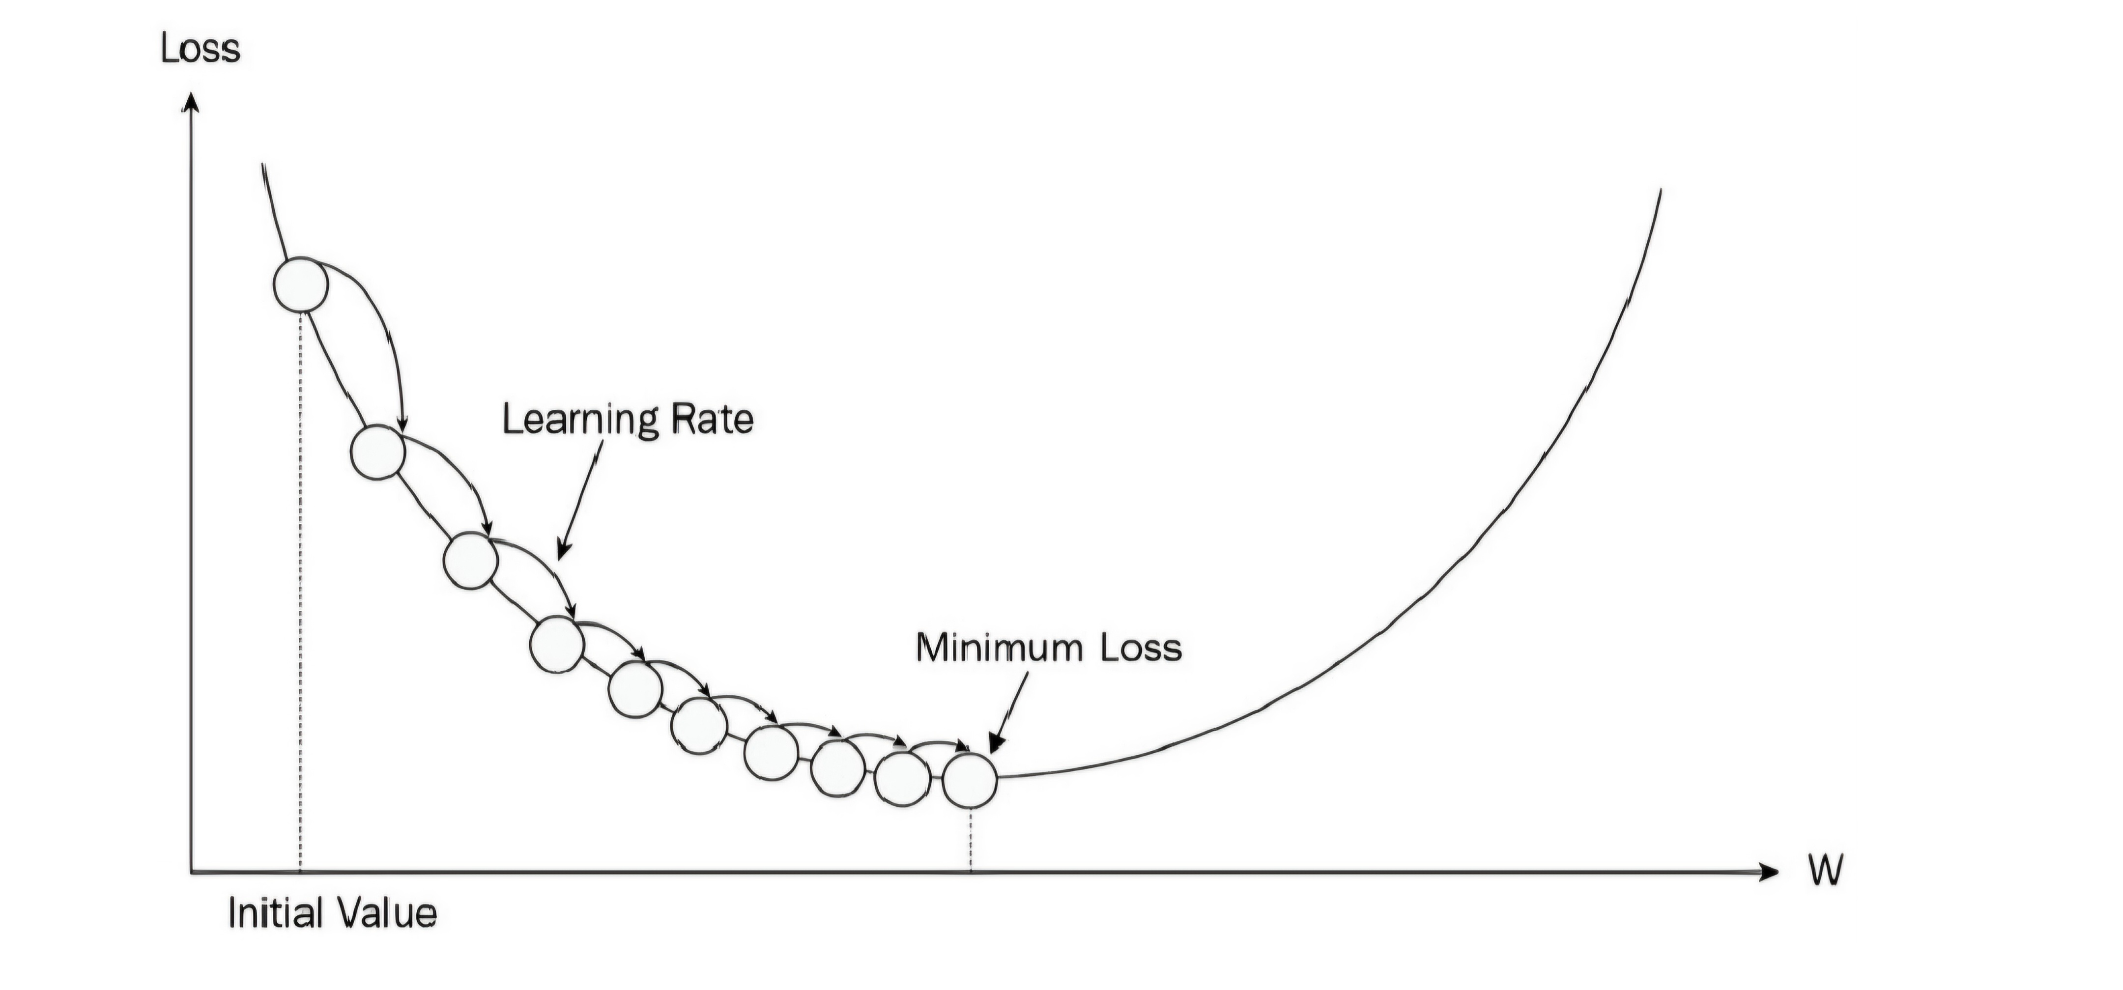
Gradient descent

Slide 5
Key Considerations for Choosing ML Algorithms
Different types of problems, like classification (categorizing) and regression (predicting numbers), require different algorithms.
The size of the dataset and the number of features (variables) also play a big role in choosing the right algorithm.
Computational efficiency: Some algorithms require significant resources to run, while others are more lightweight.
Interpretability: Simpler algorithms (e.g., decision trees) are easier to explain compared to complex models like neural networks.
It’s important to balance algorithm complexity and performance based on the problem requirements.

Slide 6
Classification and Regression Algorithms
Classification problems involve predicting a category or class, such as detecting spam emails or predicting loan approval.
Regression problems predict continuous values, such as house prices or customer lifetime value.
Both types of problems are foundational to many applications of ML, and understanding when to apply each is crucial.

Slide 7
Linear Regression
Linear regression predicts a continuous value by finding the linear relationship between input variables (features) and the output.
It’s simple and interpretable but limited to datasets with a linear relationship.
Common applications include predicting sales, housing prices, and inventory demand forecasting.
Its assumptions, such as homoscedasticity and no multicollinearity, can limit its use for more complex data.

Slide 8
Logistic Regression
Logistic regression is a classification algorithm used for predicting binary outcomes, such as ‘yes’ or ‘no’ (e.g., will a customer churn?).
It models the probability that a given input belongs to a particular category and outputs values between 0 and 1.
It’s commonly used in fields like finance (credit scoring), healthcare (disease diagnosis), and marketing (predicting customer responses).
Logistic regression provides a decision boundary that separates classes based on probabilities.

Slide 9
Decision Trees
Decision trees are non-linear models that split data into branches based on feature values, leading to a final decision at the leaf nodes.
Each decision node represents a feature, and branches are determined based on thresholds or rules.
Decision trees are versatile, handling both categorical and numerical data, and are widely used in classification and regression tasks.
A common issue with decision trees is overfitting, where the model becomes too complex and specific to the training data.

Slide 10
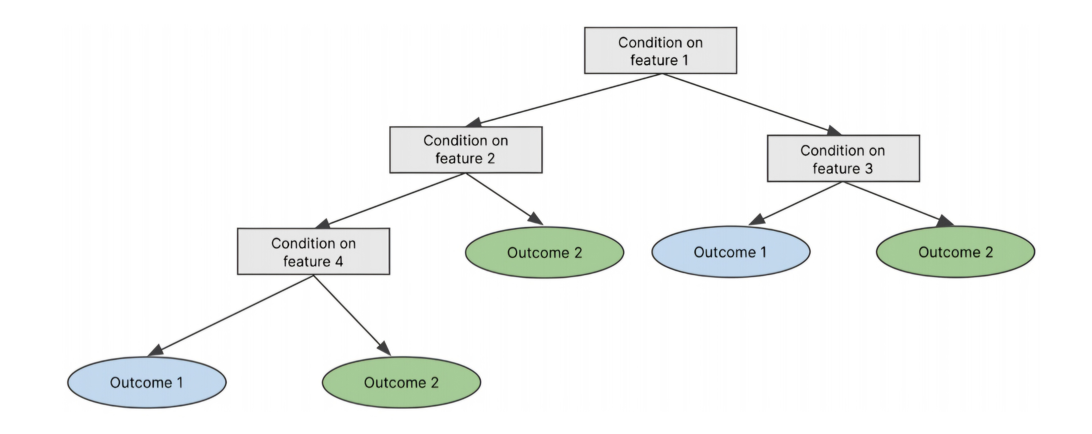
Decision tree

Slide 11
Random Forest
Random forest is an ensemble method that builds multiple decision trees on different subsets of the data and averages their results.
By introducing randomness (e.g., selecting a random subset of features), random forests reduce overfitting and increase accuracy.
They work well for both classification and regression tasks, making them versatile for various applications.
Commonly used in finance, healthcare, and retail for tasks like risk assessment and fraud detection.

Slide 12
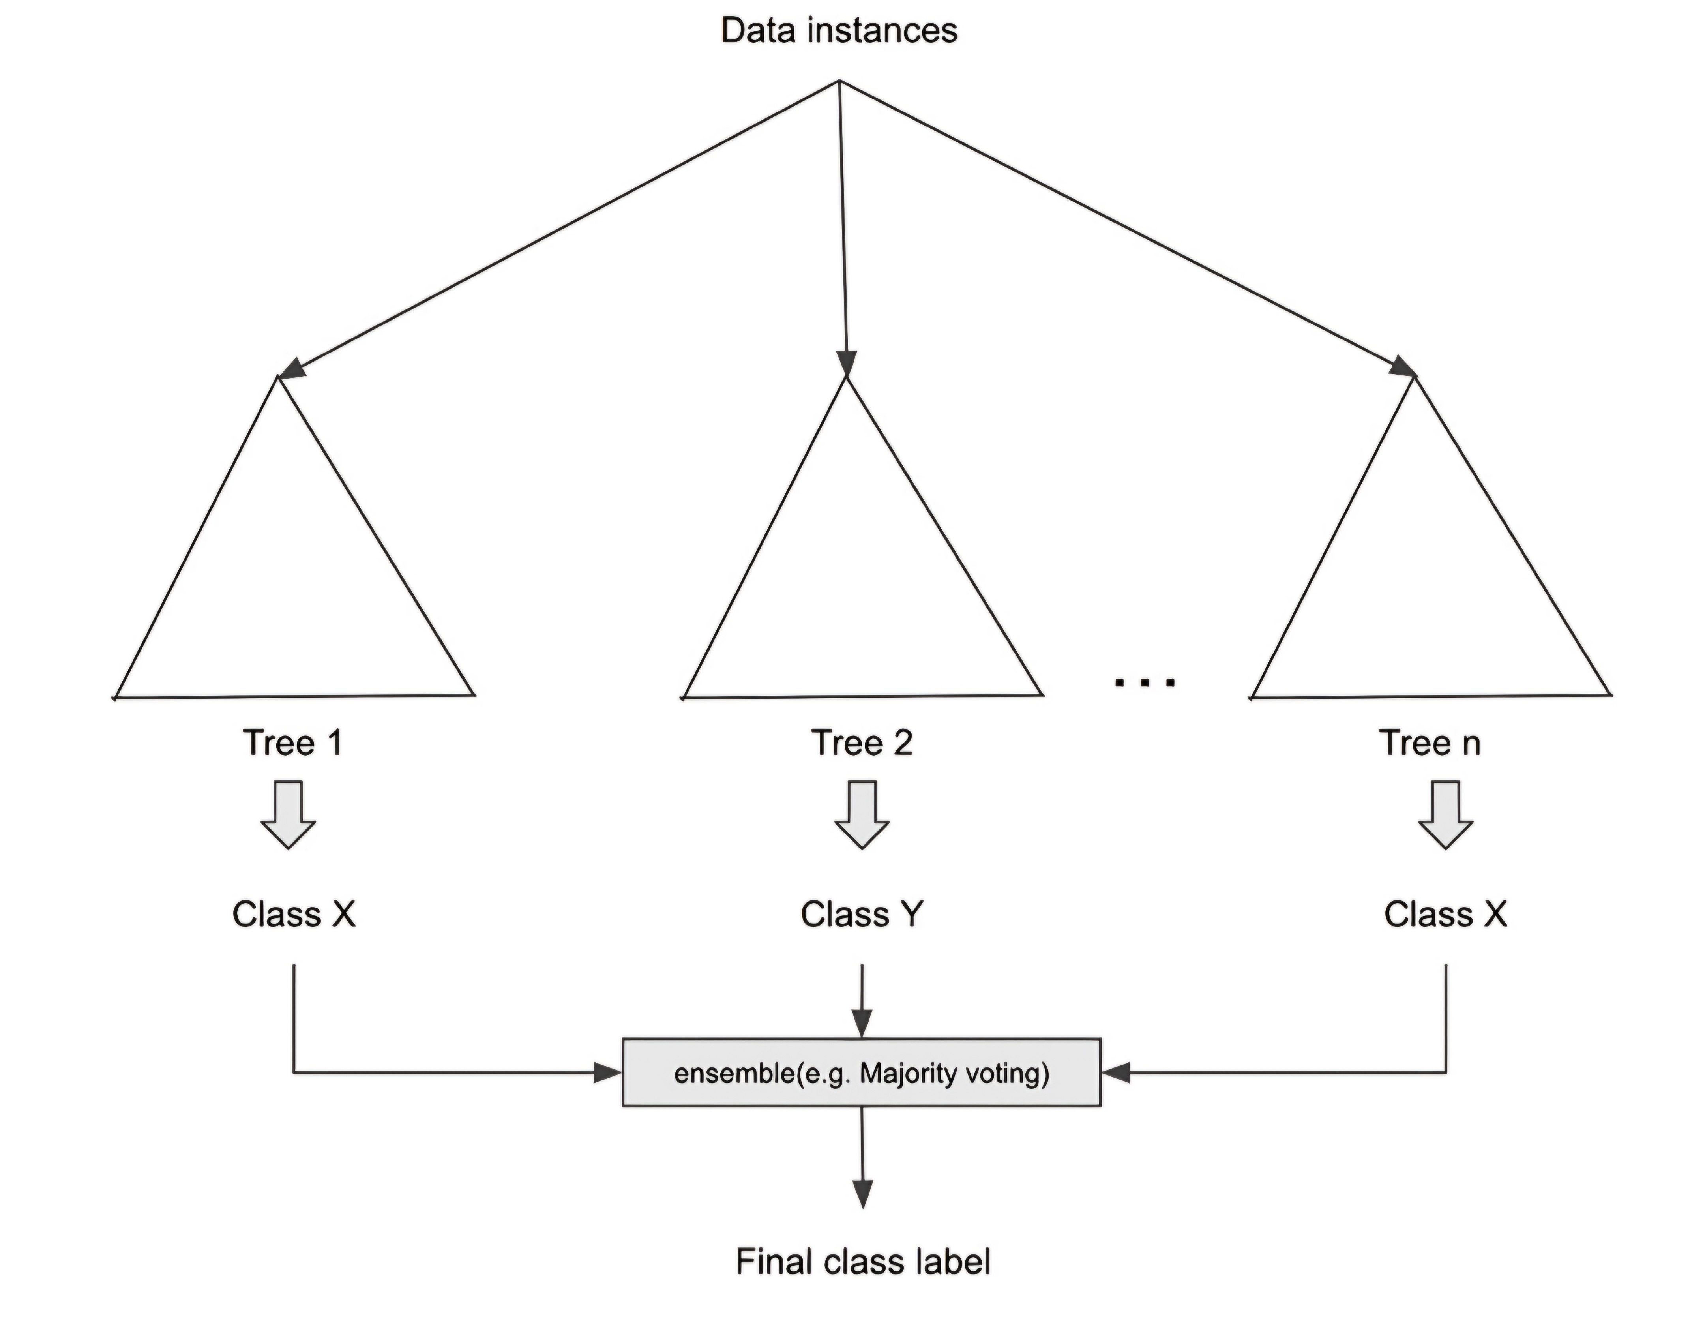
Random forest

Slide 13
Gradient Boosting & XGBoost
Gradient boosting builds models sequentially, where each new model corrects errors made by previous models.
It’s highly effective for problems where accuracy is critical, such as fraud detection, insurance claims, and predicting defaults.
XGBoost is an optimized version of gradient boosting, designed for performance and scalability.
Both algorithms are commonly used in machine learning competitions and real-world tasks where accuracy is important.

Slide 14
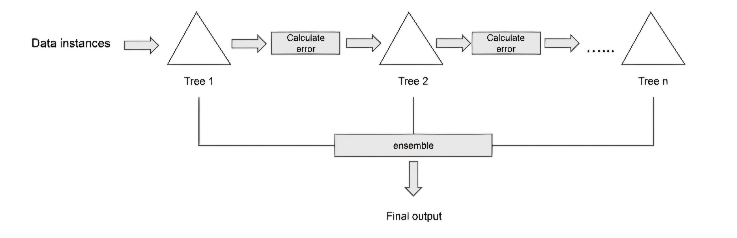
Gradient boosting

Slide 15
K-Nearest Neighbor (K-NN)
K-NN is a simple and intuitive algorithm that classifies data points based on the majority class of their nearest neighbors in the feature space.
It can also be used for regression by averaging the values of the nearest neighbors.
The model doesn’t require training; predictions are made based on the data stored during training.
However, it can be computationally expensive for large datasets, as it requires calculating the distance for each prediction.

Slide 16
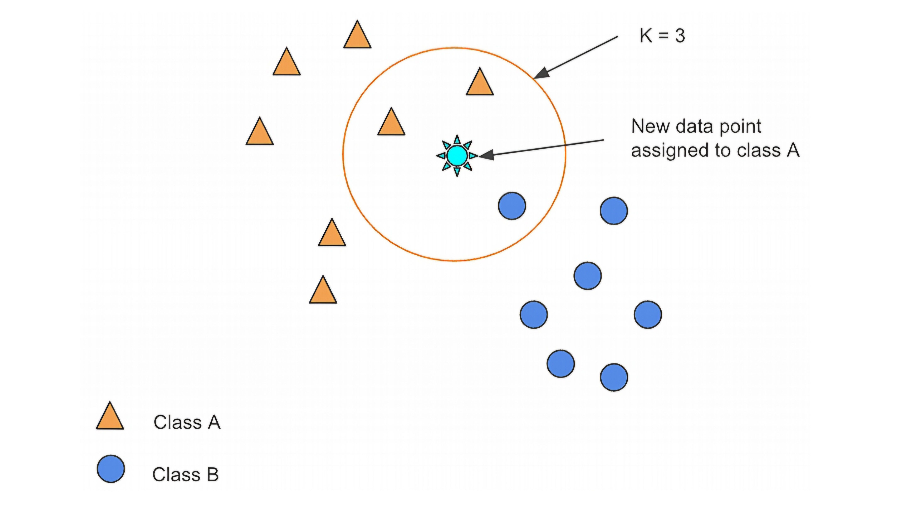
K-NN for classification

Slide 17
Multi-layer Perceptron (MLP)
MLP is a type of artificial neural network that contains one or more hidden layers to capture complex patterns in the data.
Each layer is fully connected, meaning that each neuron in one layer connects to every neuron in the next layer.
MLP is useful for complex, nonlinear relationships in data, such as image recognition or natural language processing.
It is a foundational model in deep learning, which powers many modern AI applications.

Slide 18
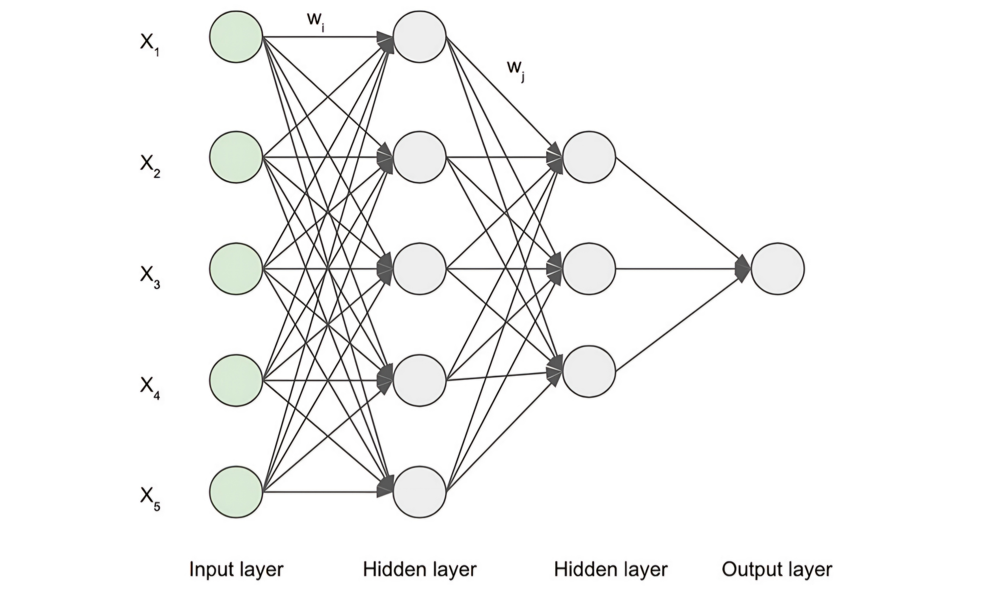
Multi-layer perception

Slide 19
Clustering Algorithms
Clustering algorithms group data points into clusters based on their similarity or distance in feature space.
Used in applications like customer segmentation, document clustering, and anomaly detection.
Clustering is an unsupervised learning technique, meaning it doesn’t require labeled data.

Slide 20
K-Means Clustering
K-means is a popular clustering algorithm that partitions data into K clusters by minimizing the distance between data points and their cluster centroids.
The algorithm iterates by updating the centroids and reassigning points to the nearest centroid.
While efficient, K-means is sensitive to the initial placement of centroids and may converge to suboptimal solutions.

Slide 21
Time Series Algorithms
Time series algorithms analyze data that evolves over time, capturing patterns such as trends, seasonality, and stationarity.
Common algorithms include ARIMA, which uses historical data to predict future values.
Time series models are widely used for forecasting in finance, retail, and operations.

Slide 22
ARIMA (Time Series Analysis)
ARIMA (Auto-Regressive Integrated Moving Average) models are used for time series forecasting, combining autoregression, moving averages, and differencing.
It’s suitable for data that shows patterns over time, such as sales data, stock prices, and inventory levels.
ARIMA assumes that the data is stationary, meaning that its statistical properties do not change over time.

Slide 23
DeepAR
DeepAR is a deep learning-based model that uses recurrent neural networks (RNNs) to model and forecast time series data.
It captures complex temporal dependencies, making it suitable for forecasting tasks involving multiple time series.
DeepAR is commonly used in large-scale retail, supply chain management, and energy consumption forecasting.

Slide 24
Recommender Systems
Recommender systems predict user preferences and recommend products, movies, or other items based on past behaviors.
Collaborative filtering uses user-item interaction data to make recommendations based on similar users’ preferences.
Multi-armed bandit models balance exploration (testing new items) and exploitation (recommending known items).

Slide 25
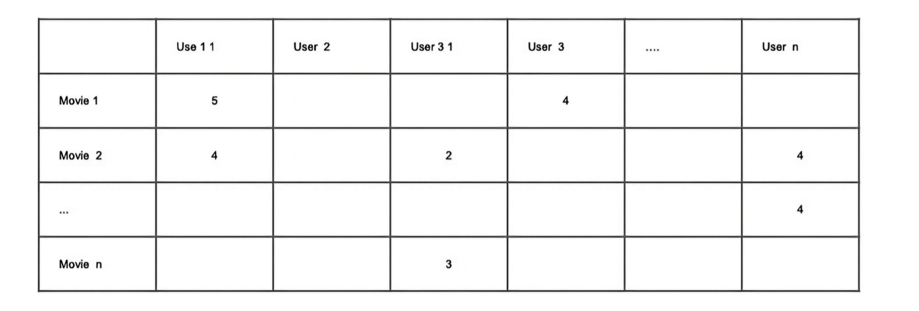
User-item interaction matrix for collaborative filtering

Slide 26
Computer Vision Algorithms
Computer vision algorithms help computers interpret and understand images and video data.
They are used in applications like autonomous vehicles, medical image analysis,and security systems.
Key tasks include object detection, facial recognition, and image segmentation.

Slide 27
Convolutional Neural Networks (CNN)
CNNs are specialized for image processing, using convolutional layers to extract spatial features and pooling layers to reduce dimensionality.
They are widely used in image classification tasks, such as identifying objects in images or diagnosing medical conditions from scans.
CNNs have been successful in applications such as self-driving cars and facial recognition.

Slide 28
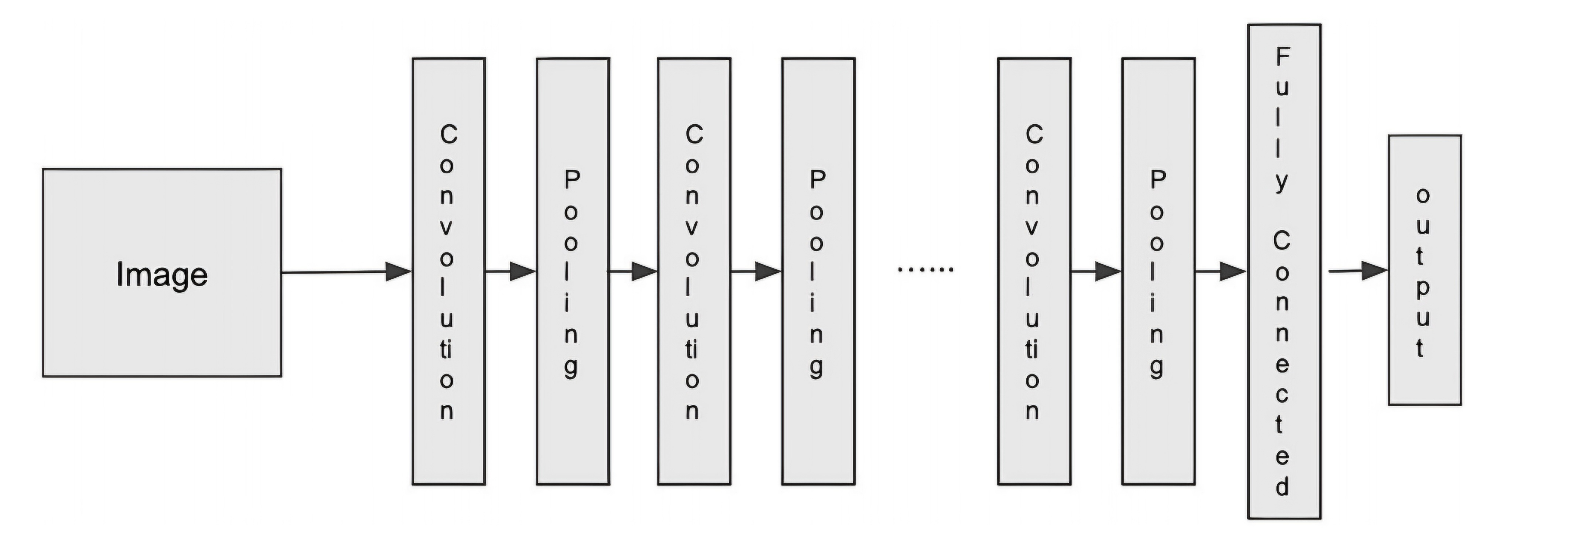
CNN architecture

Slide 29
ResNet
ResNet (Residual Networks) introduced the idea of skip connections to solve the vanishing gradient problem in deep networks.
It allows for training much deeper networks while maintaining high accuracy.
ResNet is a popular architecture in image classification tasks, and it has significantly improved the performance of deep learning models.

Slide 30
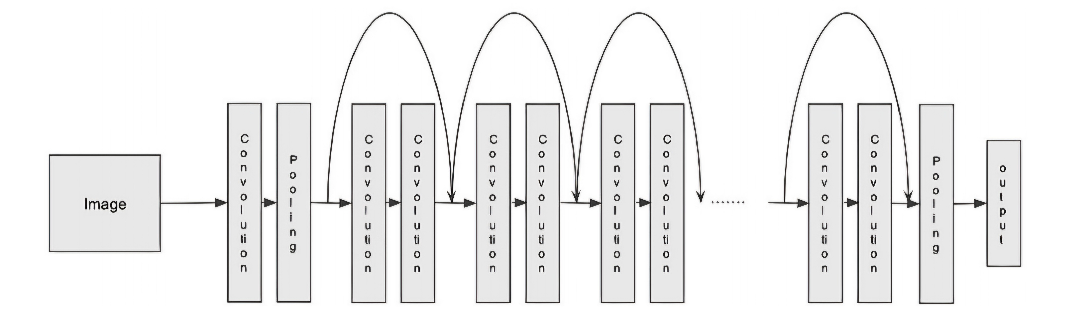
ResNet architecture:

Slide 31
NLP Algorithms
Natural Language Processing (NLP) focuses on enabling computers to understand and process human language.
Applications include text classification, language translation, sentiment analysis, and question answering.
Key techniques include word embeddings (representing words as vectors) and transformers (capturing contextual information).

Slide 32
Word2Vec
Word2Vec generates vector representations of words, capturing their semantic meanings and relationships.
It is useful for tasks like text classification, entity recognition, and document clustering.
The two main techniques used in Word2Vec are Continuous Bag of Words (CBOW) and Skip-gram, each offering different advantages.

Slide 33
BERT
BERT (Bidirectional Encoder Representations from Transformers) is a transformer-based model that creates contextualized word embeddings.
It predicts masked words in a sentence, allowing it to understand the meaning of words based on their context.
BERT is widely used for tasks like reading comprehension, sentiment analysis, and question answering.

Slide 34
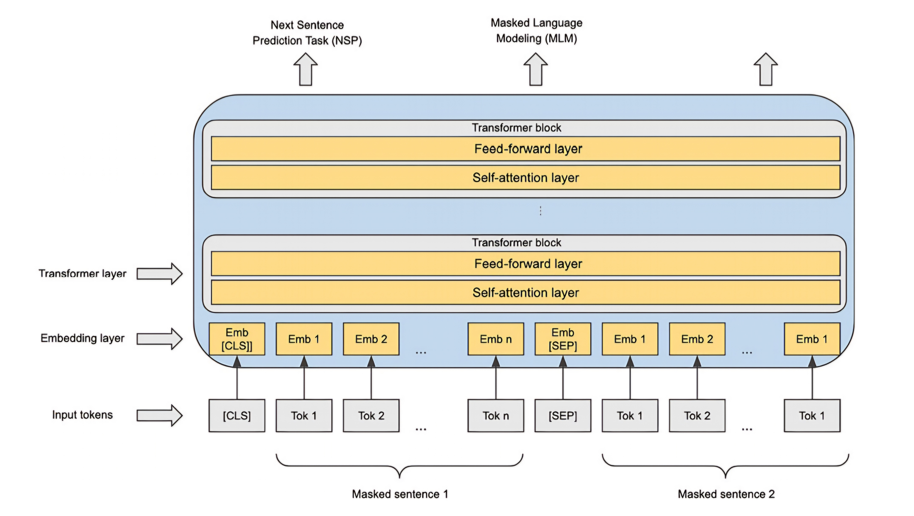
BERT model pre-training:

Slide 35
Generative AI Algorithms
Generative Adversarial Networks (GANs) are used to generate realistic synthetic data such as images, videos, and audio.
GPT models, like GPT-3, are powerful text generation models that predict the next word in a sentence.
These models are used in applications such as image synthesis, text completion, and content creation.

Slide 36
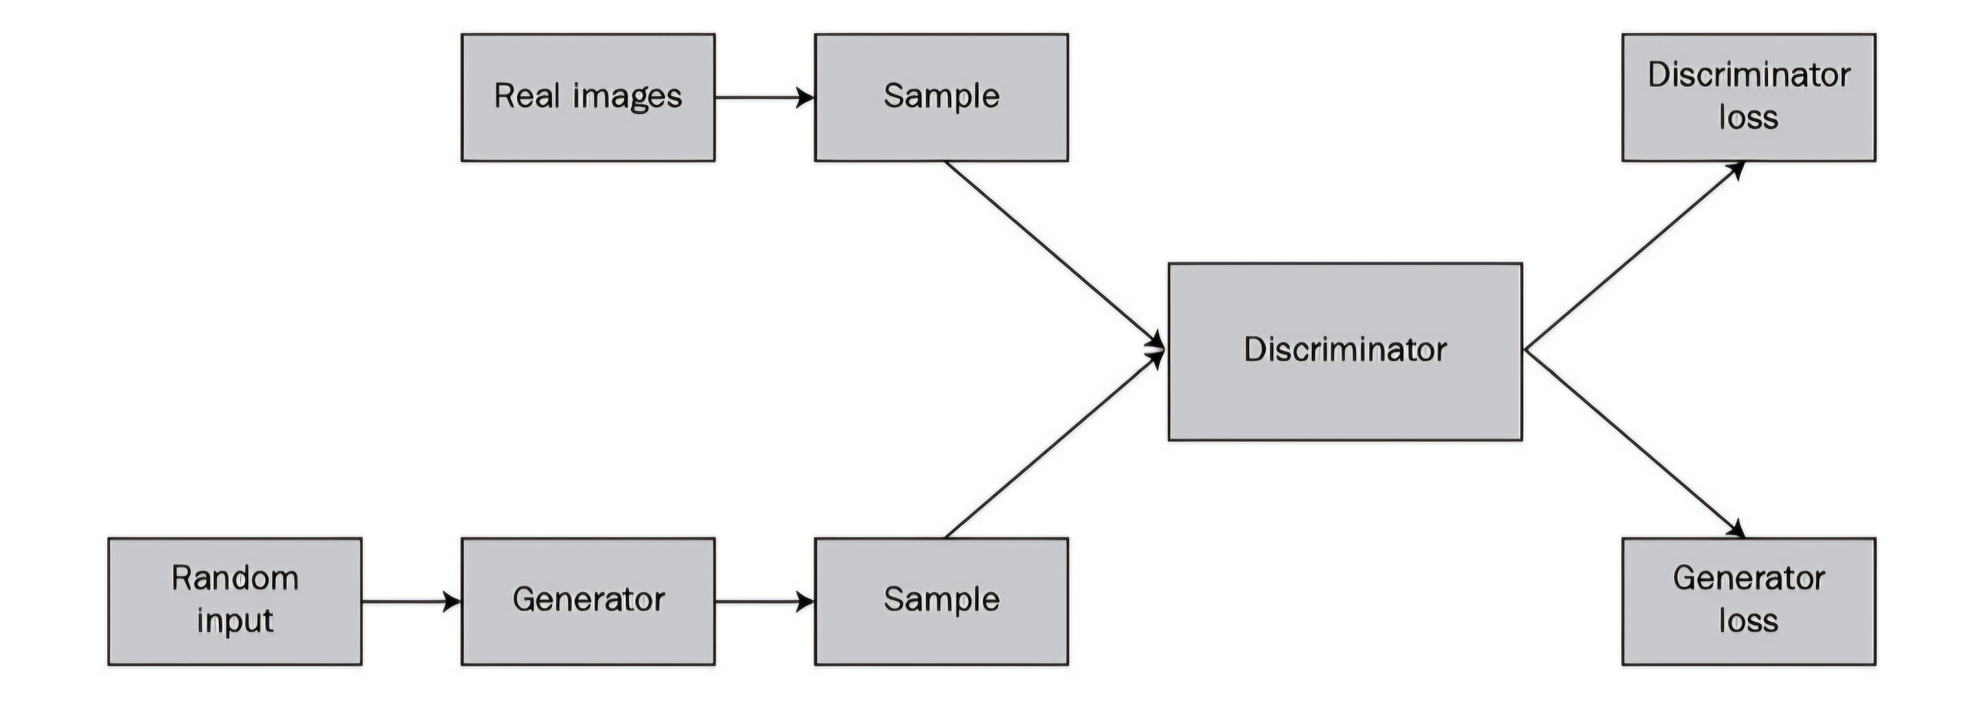
GAN Architecture

Slide 37
Conclusion
Understanding a wide range of machine learning algorithms is crucial for solving diverse business challenges.
Selecting the right algorithm based on the problem type, data characteristics, and computational requirements can optimize performance and outcomes.
Machine learning applications span across various industries, including healthcare, finance, retail, and beyond, with the potential to drive significant innovation.

